Slide 1

Topic 7
The structure of the vegetative organs of plants and their modifications

Slide 2
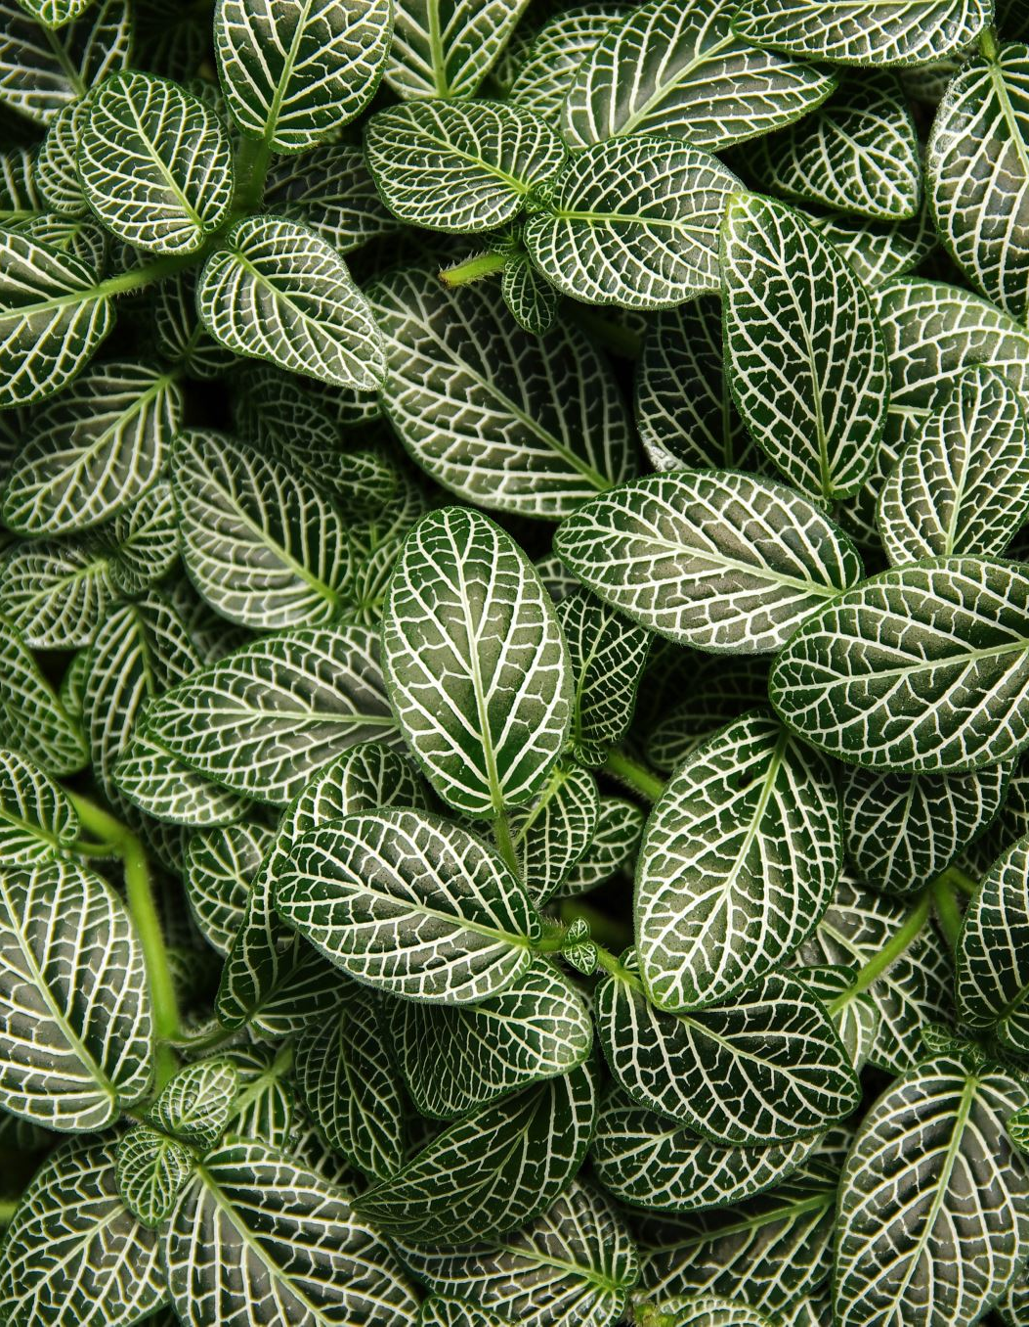
Introduction
Vegetative plant organs are essential structures involved in the growth, development, and overall functioning of a plant. These organs primarily help in processes such as nutrition, water transport, and structural support. Unlike reproductive organs, which are involved in the plant’s reproduction, vegetative organs are involved in the plant’s vegetative or non-reproductive growth.
Key Components:
Roots: Anchor the plant and absorb water and nutrients.
Stems: Support the plant and transport water, nutrients, and sugars.
Leaves: Perform photosynthesis, produce energy, and exchange gases.

Slide 3
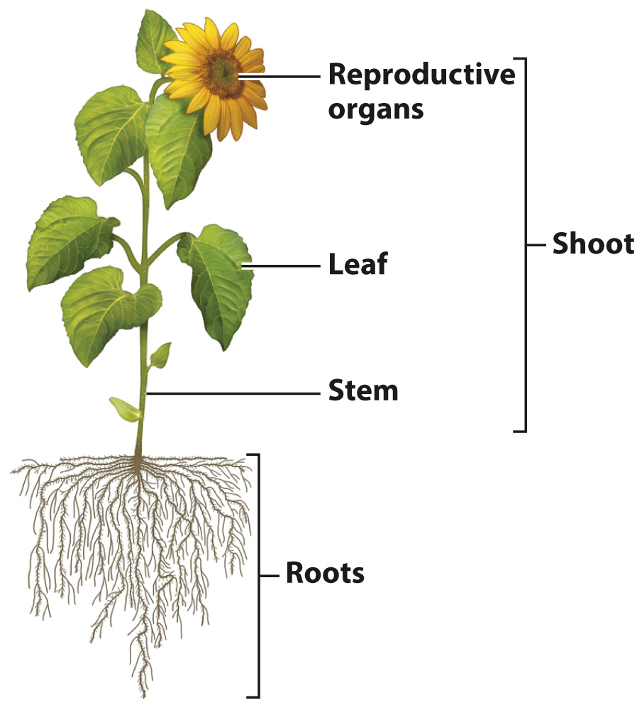
Functions of Vegetative Plant Organs
1. Roots
Anchor the plant to the soil for stability.
Absorb water and nutrients from the soil.
Store food and energy (e.g., in tubers or roots like carrots).
2. Stems
Support the plant and elevate leaves, flowers, and fruits.
Transport water, minerals, and nutrients between roots and leaves.
Store nutrients in some plants (e.g., in cactus stems).
3. Leaves
Photosynthesis: Convert light energy into chemical energy (glucose).
Gas exchange: Facilitate the intake of CO₂ and release of O₂.
Transpiration: Regulate water loss through stomata.

Slide 4
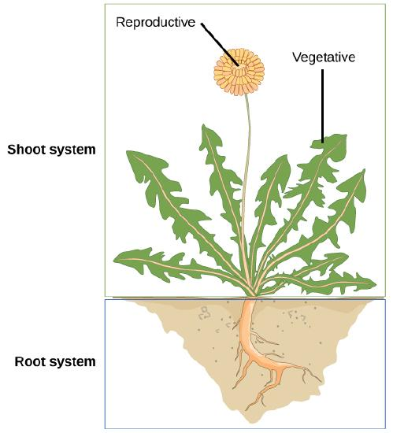
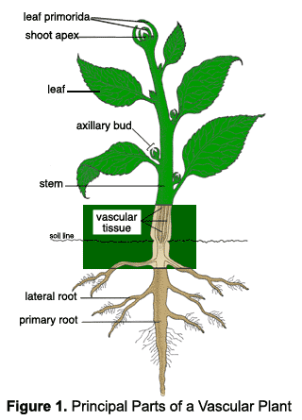
Vegetative organs
Vegetative organs of plants - parts of the plant that perform the main functions of nutrition and metabolism with the external environment.
The three main types of vegetative organ are the root, stem and leaf. Roots typically occur underground, and extract moisture and nutrients from the soil, though there are many examples of plants with aerial roots. The stem and leaves together comprise the shoot.

Slide 5
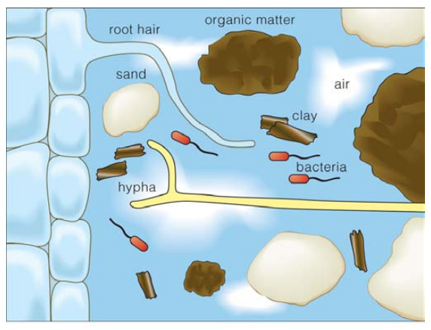
CHARACTERISTICS OF ROOTS
Non-green due to absence of chlorophyll;
Not divided into nodes and internodes;
Absence of leaves and buds;
Positively geotropic (grow towards gravity);
Positively hydrotropic (grow towards water);
Negatively phototropic (grow away from light).

Slide 6
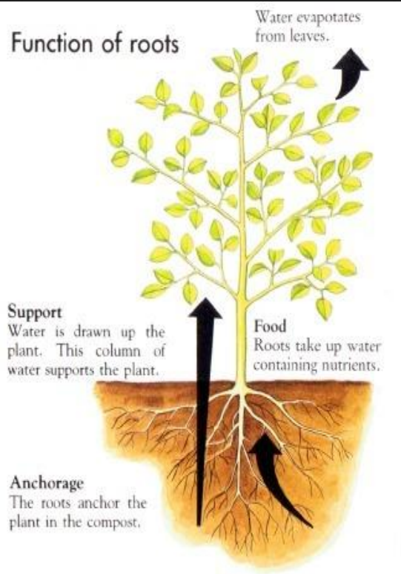
FUNCTIONS OF ROOTS
(i) Anchorage – Roots anchor the plant firmly to the soil (mechanical function).
(ii) Absorption – Roots absorb water and mineral salts and conduct them upwards (physiological function).
(iii) Special functions – By undergoing modifications in their structure, roots perform special physiological functions like food storage, assimilation, absorption of atmospheric moisture, sucking food from host, better gaseous exchange and mechanical functions like floating (buoyancy), stronger anchorage and climbing.

Slide 7
TYPES OF ROOTS
Tap root – It is the primary and the main root that develops from the radicle, bears numerous branches and remains underground. It is usually found in dicots e.g. sunflower, mustard, carrot, mango.
Adventitious root – These are roots that develop from any part of the plant except the radicle. They may be aerial or underground. They may grow from node (money plant, bamboo), stem cutting (rose), tree branch (banyan) or stem base (fibrous roots in monocots).

Slide 8
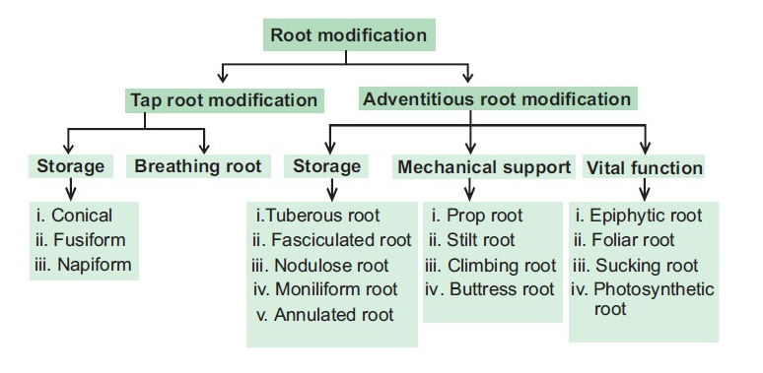

Slide 9
Modifications of Tap Roots
For Food Storage
Depending upon their shapes, they are classified as;
Conical roots are broad at the base and conical at the apex, eg., carrot
Fusiform roots are swollen in the middle and tapering towards both the ends, eg., radish
Napiform roots are spherical at the base and taper towards the apex, eg., turnip
Tuberous roots have no specific shape. They appear thick and fleshy, eg., sweet potato

Slide 10
For better Respiration
In some halophytes such as Rhizophora that grow in swampy areas, the roots emerge out of the ground and grow upwards to get oxygen for respiration. The root tips of these plants have minute pores called lenticels through which they respire.

Slide 11
Nodulated Roots
Roots of the leguminous plants are modified into root nodules which contain nitrogen-fixing bacteria such as Rhizobium. They help in fixing the atmospheric nitrogen into nitrates and make it available to the plant.

Slide 12
Modification of Adventitious Roots
For Food Storage
Simple Tuberous Roots are swollen and do not assume any shape. For eg., sweet potato
Nodulose Roots are single beads. They become swollen at the apex and have a definite shape, eg., ginger
Fasciculated Tuberous Roots is the cluster of adventitious roots for food storage. They have a definite shape, eg., Dahlia
Moniliform Roots are swollen and constricted, eg., grasses
Annulated Roots has an appearance of discs placed one over the other, eg., Ipecac.

Slide 13
For Support
Prop Roots: These roots develop from the branches of the tree, hang downwards, and penetrate into the ground thereby supporting the tree. Eg., roots of the banyan tree.
Stilt Roots: These roots grow obliquely from the basal node of the stem. Eg., roots of the sugarcane.
Climbing Roots: These roots arise from the nodes and attach themselves to some support to climb over it. Thus, they provide support to the plant. Eg., Money plant
Clinging Roots: These roots enter the crevices of some support and fix the plant. Eg., epiphytes orchids
Buttress Roots: These are vertically elongated basal part of the stem which spread in different directions in the soil. These are horizontally compressed and appear like planks. Eg., Bombax.

Slide 14
For Special Functions
Epiphytic Roots: These roots are aerial, hanging and spongy. They have a porous wall and absorb moisture from the atmosphere. These aerial roots possess a special sponge-like tissue known as velamen. Velamen absorbs and stores moisture from the air since these plants do not have direct contact with the soil.
Sucking Roots: These are microscopic, developed by the roots to absorb nutrients from the host. These are also known as parasitic roots or haustoria because these are found in non-green parasitic plants. These roots arise from the nodes and penetrate into the host tissue. They then enter into the conducting tissue from where they obtain the required food material.
Floating Roots: These arise from the nodes of the aquatic plants and help in floating and respiration. Eg., Jussiaea. These roots are very spongy in nature and look like a mass of white cotton. The plant floats due to its buoyancy. They dry when taken out of the water.
Assimilatory Roots: These are also known as photosynthetic roots. These, when exposed to the sun, develop chlorophyll and manufacture food. Eg., In Tinospora, the roots hang as green threads from the nodes during the rainy season. They assimilate carbon dioxide in the presence of sunlight.
Mycorrhizal Roots: The symbiotic association of a fungus with higher plants is called mycorrhizal root. The fungus absorbs nutrients from the soil for the plant, and the plant, in turn, provides organic food to it. Eg., Pinus
Reproductive Roots: In some plants such as sweet potato, the adventitious roots give rise to buds which develop into leafy shoots. Root cuttings are the main mode of reproduction.

Slide 15
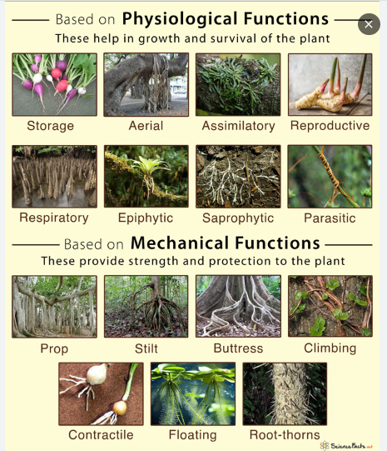
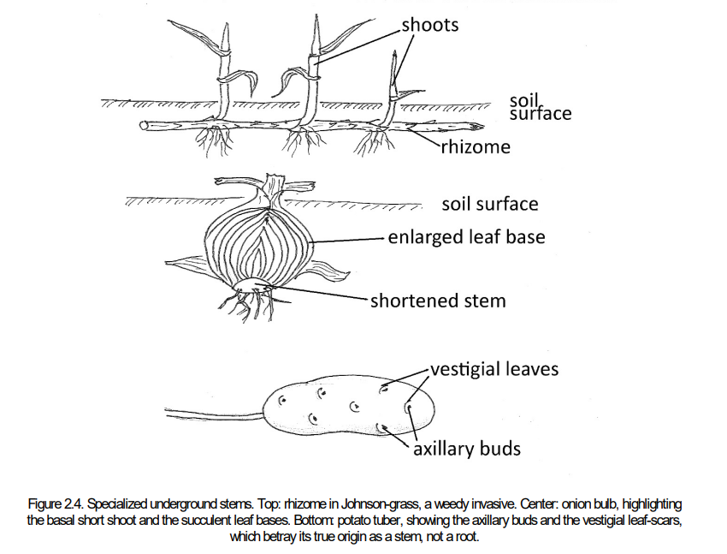

Slide 16
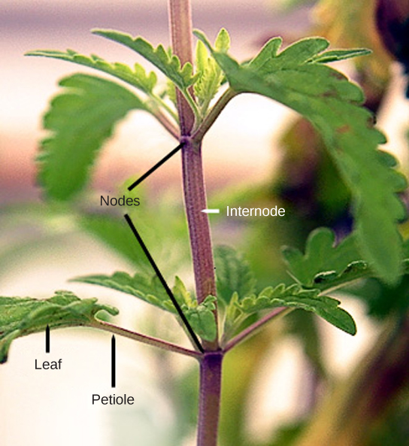
The morphological structure of the stem
Stems are a part of the shoot system of a plant. They may range in length from a few millimeters to hundreds of meters, and also vary in diameter, depending on the plant type. Stems are usually above ground, although the stems of some plants, such as the potato, also grow underground. Stems may be herbaceous (soft) or woody in nature.
A stem may be unbranched, like that of a palm tree, or it may be highly branched, like that of a magnolia tree. The stem of the plant connects the roots to the leaves, helping to transport absorbed water and minerals to different parts of the plant. It also helps to transport the products of photosynthesis, namely sugars, from the leaves to the rest of the plant.

Slide 17
Stem Function & Types
Three important functions:
  Produce leaves, branches and flowers
  Hold leaves up in the sunlight
  Transport substances between roots and leaves
Two types:
  Monocot – has vascular bundles that contain the xylem & phloem scattered randomly
  Dicot – have vascular bundles organized in a ringlike pattern

Slide 18
Stem Modifications
Some plant species have modified stems that are especially suited to a particular habitat and environment.
Underground Modifications
A rhizome is a modified stem that grows horizontally underground and has nodes and internodes. Vertical shoots may arise from the buds on the rhizome of some plants, such as ginger and ferns.
Corms are similar to rhizomes, except they are more rounded and fleshy (such as in gladiolus). Corms contain stored food that enables some plants to survive the winter.
Stolons are stems that run almost parallel to the ground, or just below the surface, and can give rise to new plants at the nodes.
Runners are a type of stolon that runs above the ground and produces new clone plants at nodes at varying intervals: strawberries are an example.
Tubers are modified stems that may store starch, as seen in the potato (Solanum sp.). Tubers arise as swollen ends of stolons, and contain many adventitious or unusual buds (familiar to us as the “eyes” on potatoes).
A bulb, which functions as an underground storage unit, is a modification of a stem that has the appearance of enlarged fleshy leaves emerging from the stem or surrounding the base of the stem, as seen in the iris.

Slide 19
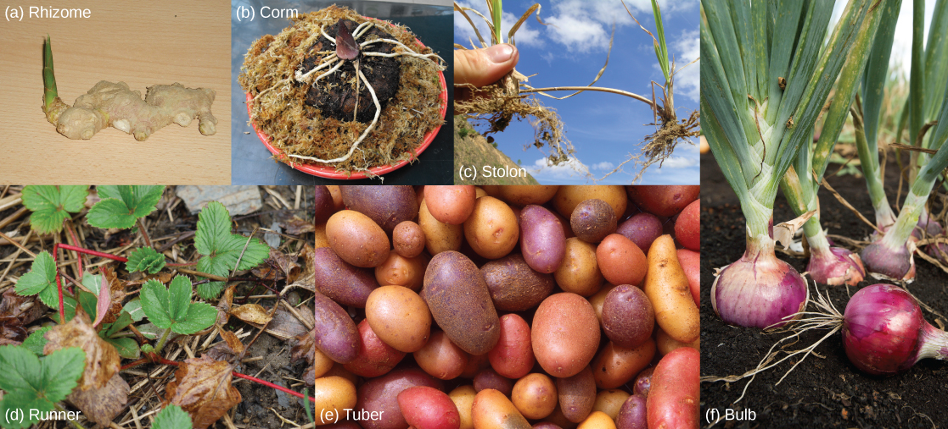
Stem modifications enable plants to thrive in a variety of environments. Shown are (a) ginger (Zingiber officinale) rhizomes, (b) a carrion flower (Amorphophallus titanum) corm (c) Rhodes grass (Chloris gayana) stolons, (d) strawberry (Fragaria ananassa) runners, (e) potato (Solanum tuberosum) tubers, and (f) red onion (Allium) bulbs.

Slide 20
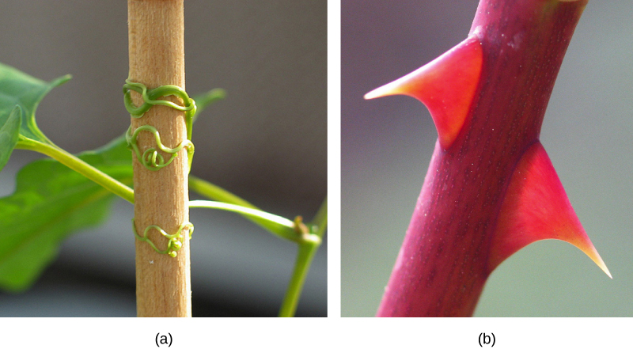
Above ground modifications
Tendrils are slender, twining strands that enable a plant (like a vine or pumpkin) to seek support by climbing on other surfaces.
Thorns are modified branches appearing as sharp outgrowths that protect the plant; common examples include roses, Osage orange and devil’s walking stick.
Found in southeastern United States, (a) buckwheat vine (Brunnichia ovata) is a weedy plant that climbs with the aid of tendrils. This one is shown climbing up a wooden stake. (b) Thorns are modified branches.

Slide 21
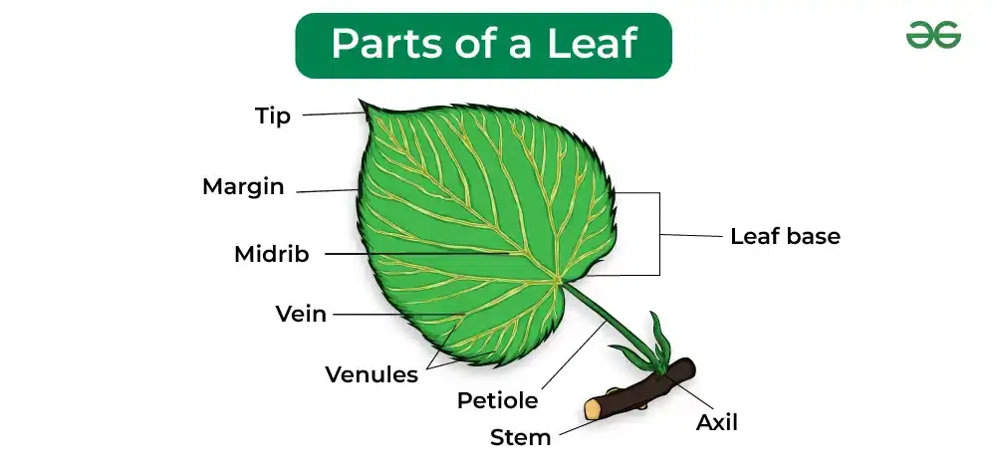
Morphology of leaves
Leaf Functions
Photosynthesis – takes place in the mesophyll cells of the leaf
Transpiration – the loss of water from a plant through its leaves (helps to pull water up from the roots)
Gas exchange – taking in carbon dioxide and releasing oxygen

Slide 22
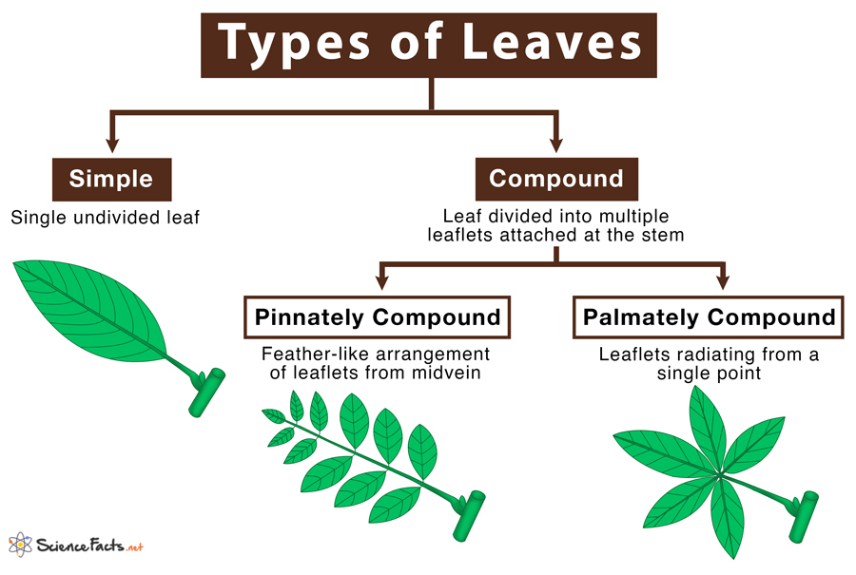

Slide 23
1. Simple Leaves
It is a single leaf with undivided leaflets that are directly attached to the stem. It is always attached to a twig by its stem or the petiole.
Examples: Maple, oaks, banana, guava, mango, black cherry, black gum and, sweat gum.
2. Compound Leaves
A leaf that is composed of multiple leaflets that are attached to the midvein, and having their own stalk.
Examples: Neem, rose, clover, desert cotton, poison ivy, horse chestnut and, baobab.

Slide 24
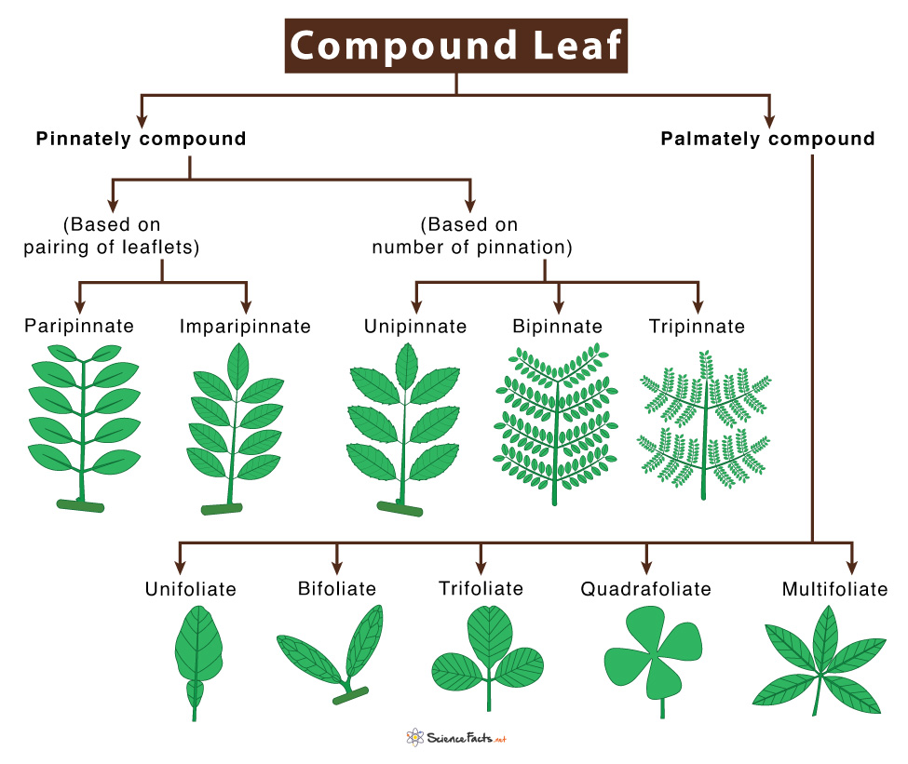

Slide 25
Based on the types of leaf veins and their arrangement in the lamina, compound leaves are further classified into two types:
a) Pinnately Compound Leaf
They are leaflets arranged symmetrically along the center of the leaf, where each leaflet appears to be attached or pinned to the midrib making the leaf look like a feather.
Based on pairing of leaflets pinnately compound leaves are categorized into the following types:
Paripinnate (even-pinnate): Leaflets are borne in pairs along the rachis, ending with a pair of leaflets on either side
Imparipinnate (odd-pinnate): Unlike paripinnate, here, a single leaflet is present at the anterior terminal end of the rachis
Examples: Pistachia lenticulus (paripinnate), Robinia (imparipinnate).

Slide 26
Depending on the number of times the leaflet is attached to the midrib (pinnation), pinnately compound leaves are categorized into the following types:
unipinnate – single compound leaf attached to the midrib in an opposite fashion (Azadirachta indica)
bipinnate – single leaflets of the unipinnate leaf gets replaced with unipinnate leaves (Bailey Acacias, silk trees, flamegolds, chinaberries, and Jerusalem thorns)
tripinnate – single leaflets of the unipinnate leaf gets replaced with bipinnate leaves (Moringa oleifera)
Examples: Azadirachta indica (unipinnate), Mimosa pudica (bipinnate) and, Moringa oleifera (tripinnate).

Slide 27
b) Palmately Compound Leaf
They are leaflets radiating outwards from the end of the petiole, similar to fingers of the palm of our hands.
Based on the number of leaflets, the palmately compound leaf is categorized into the following types:
unifoliate – one leaflet
bifoliate – two leaflets
trifoliate – three leaflets
quadrifoliate – four leaflets
multifoliate – five or more leaflets
Examples: Citrus limon (unifoliate), Bauhinia yunnanensis (bifoliate), Acer cissifolium (trifoliate), Oxalis (quadrifoliate) and, Umbrella plant (multifoliate).

Slide 28
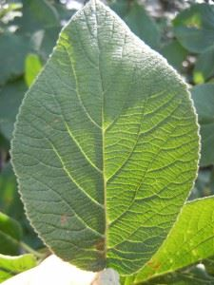

Venation
Venation is defined as the arrangement of veins and the veinlets in the leaves. Different plants show different types of venation. Generally, there are two types of venation:
Reticulate venation: In a reticulate venation, the veinlets are randomly arranged and form a complex network of veinlets. Ex: Dicotyledonous plants like a rose plant.
Parallel venation: In a parallel venation, the veinlets run parallel to each other. Ex: In monocotyledons like paddy.
Reticulate venation
Parallel venation:

Slide 29
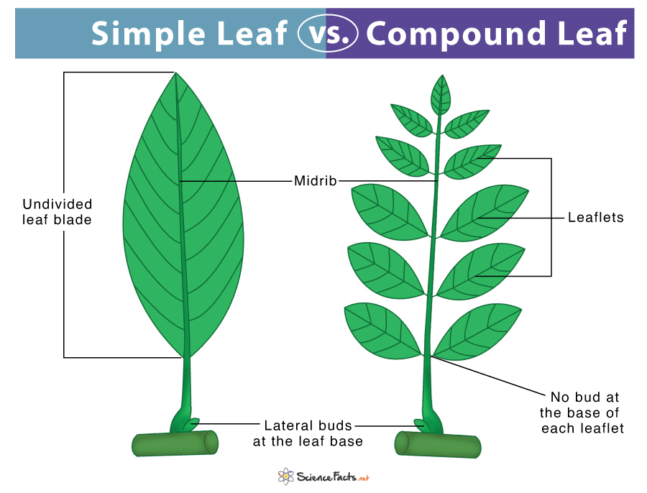

Slide 30
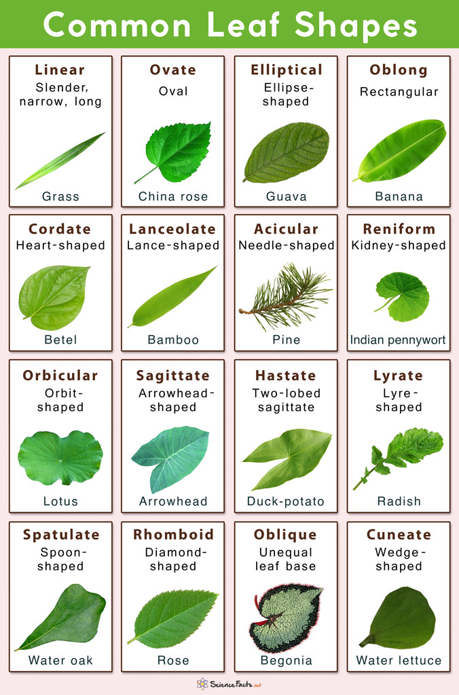

Slide 31
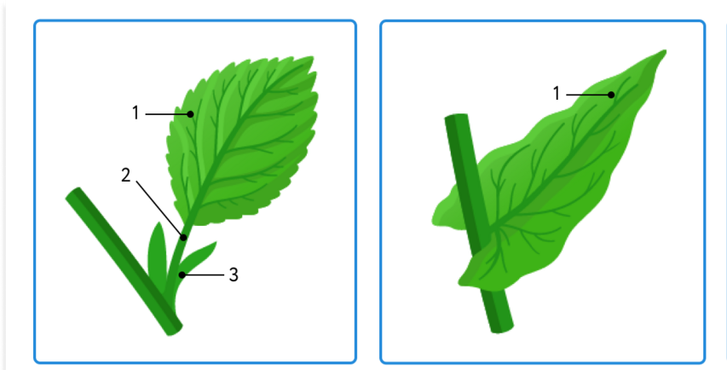
Characteristic according present or absent petiole
Leaf attachment to stem
Leaves which have a petiole (leaf stalk) are said to be petiolate.
Sessile (epetiolate) leaves have no petiole and the blade attaches directly to the stem

Slide 32
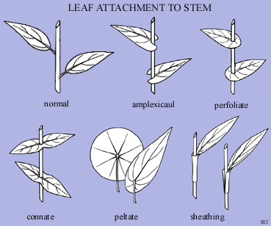
amplexicaul: of a leaf base, stem-clasping.
connate: fused to another organ (or other organs) of the same kind. cf. adnate.
peltate: of a leaf, having the stalk attached to the lower surface of the blade, not to the margin (also applied, in the same sense, to other stalked structures).
perfoliate: of a sessile leaf or bract, having its base completely wrapped around the stem.
sheath: the lower portion of a grass leaf, clasping the stem; one of the wing-like extensions to the margins of the petiole which wrap around and enclose the stem; closed sheath: one in which the wings are fused to form a cylinder; open sheath: one with a slit on the side opposite to the lamina.

Slide 33
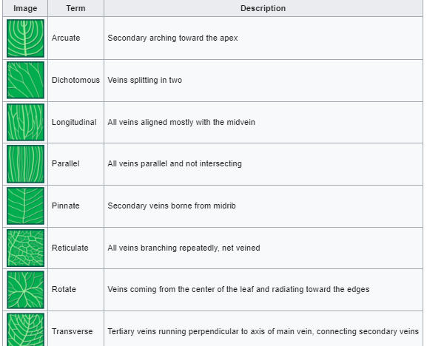
Diagram of venation
patterns

Slide 34








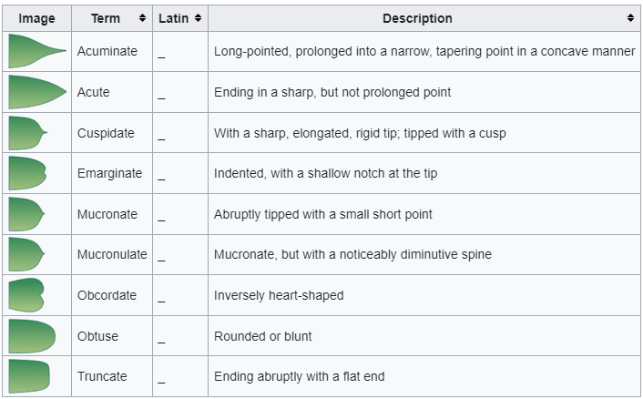
Apex (Tips)

Slide 35
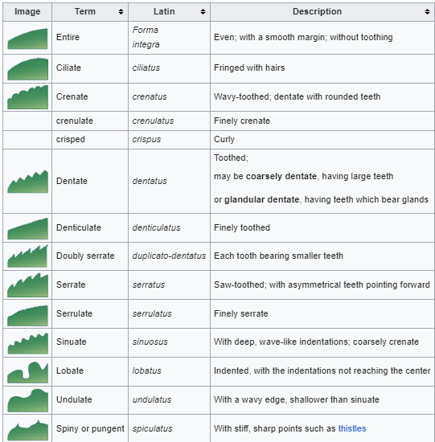
Margins

Slide 36
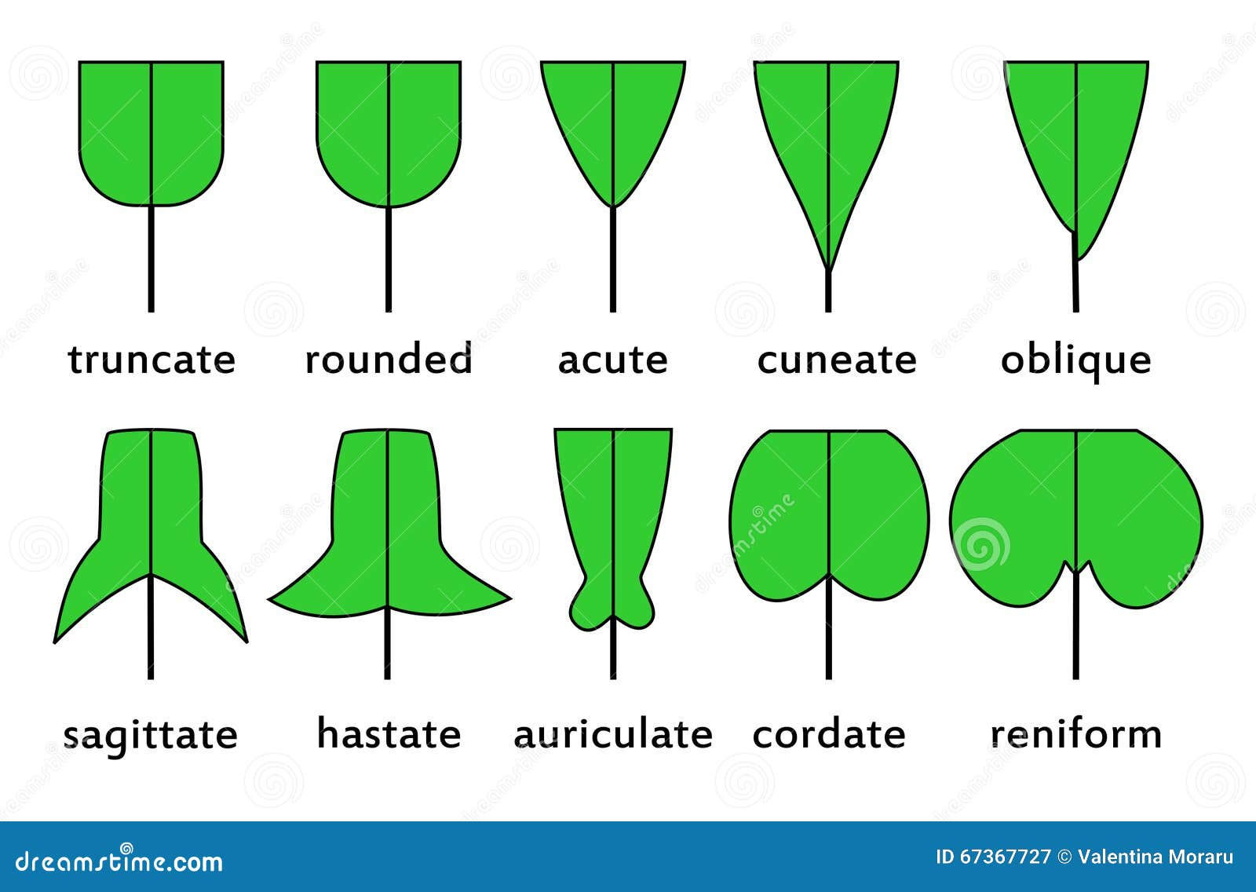
Leaf basis

Slide 37
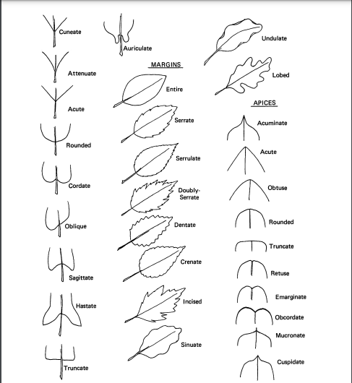

Slide 38
The surface of a leaf can be described by several botanical terms:
farinose: bearing farina; mealy, covered with a waxy, whitish powder.
glabrous: smooth, not hairy.
glaucous: with a whitish bloom; covered with a very fine, bluish-white powder.
glutinous: sticky, viscid.
papillate, papillose: bearing papillae (minute, nipple-shaped protuberances).
pubescent: covered with erect hairs (especially soft and short ones)
punctate: marked with dots; dotted with depressions or with translucent glands or colored dots.
rugose: deeply wrinkled; with veins clearly visible.
scurfy: covered with tiny, broad scalelike particles.
tuberculate: covered with tubercles; covered with warty prominences.
verrucose: warted, with warty outgrowths.
viscid, viscous: covered with thick, sticky secretions.

Slide 39
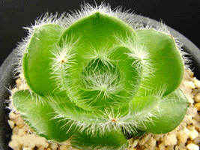
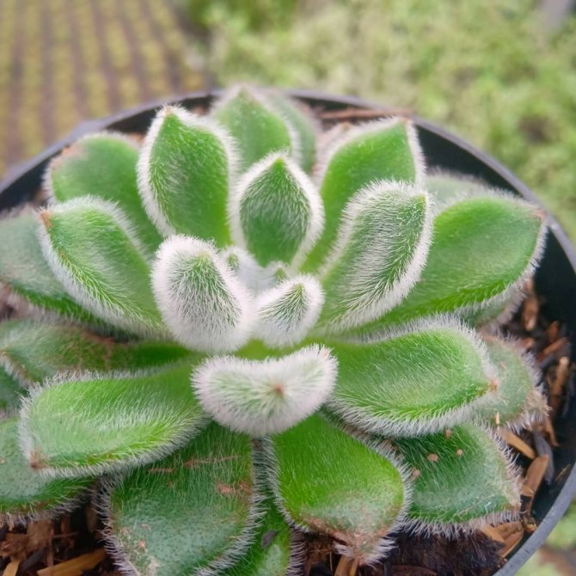
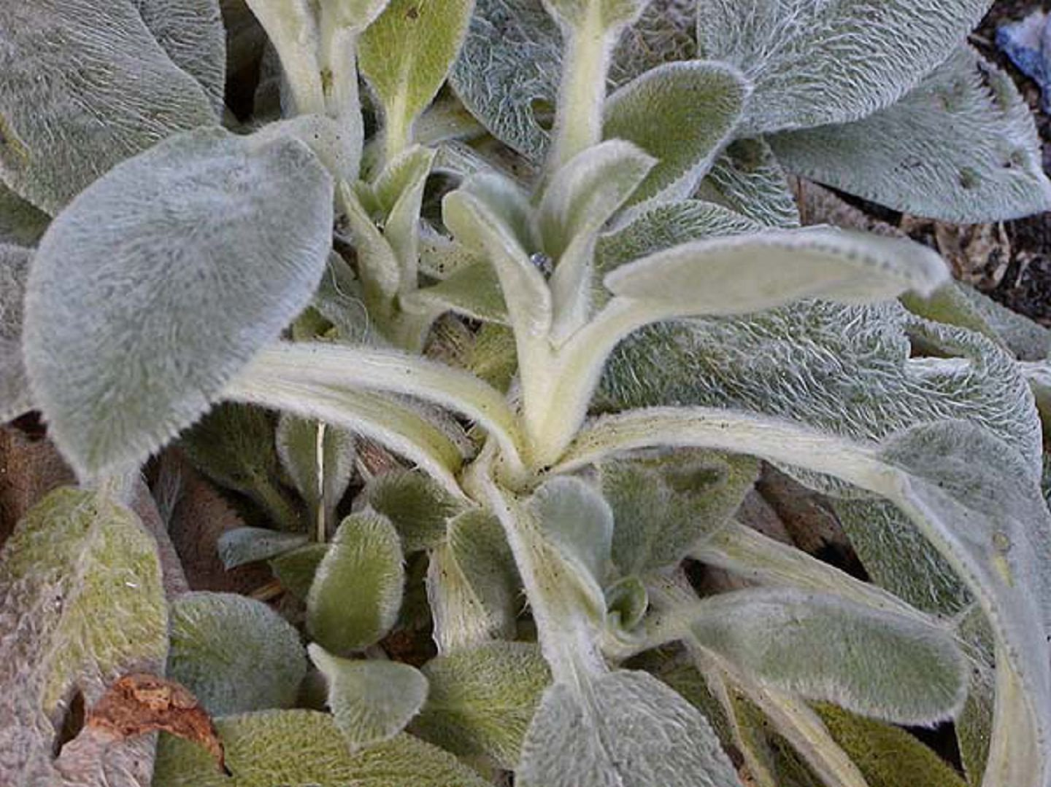
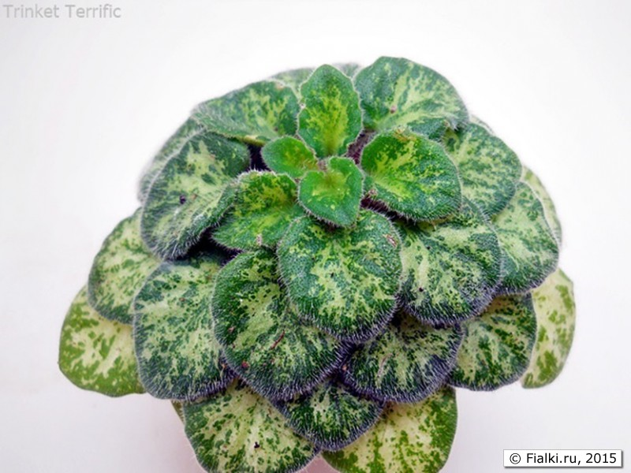
"Hairs" on plants are properly called trichomes. Leaves can show several degrees of hairiness. The meaning of several of the following terms can overlap.
glabrous: no hairs of any kind present.
arachnoid, arachnose: with many fine, entangled hairs giving a cobwebby appearance.
barbellate: with finely barbed hairs (barbellae).
bearded: with long, stiff hairs.
bristly: with stiff hair-like prickles.
canescent: hoary with dense grayish-white pubescence.
ciliate: marginally fringed with short hairs (cilia).
ciliolate: minutely ciliate.
floccose: with flocks of soft, woolly hairs, which tend to rub off.
glandular: with a gland at the tip of the hair.
hirsute: with rather rough or stiff hairs.
hispid: with rigid, bristly hairs.
hispidulous: minutely hispid.
hoary: with a fine, close grayish-white pubescence.
lanate, lanose: with woolly hairs.
pilose: with soft, clearly separated hairs.
puberulent, puberulous: with fine, minute hairs.
pubescent: with soft, short and erect hairs.

Slide 40
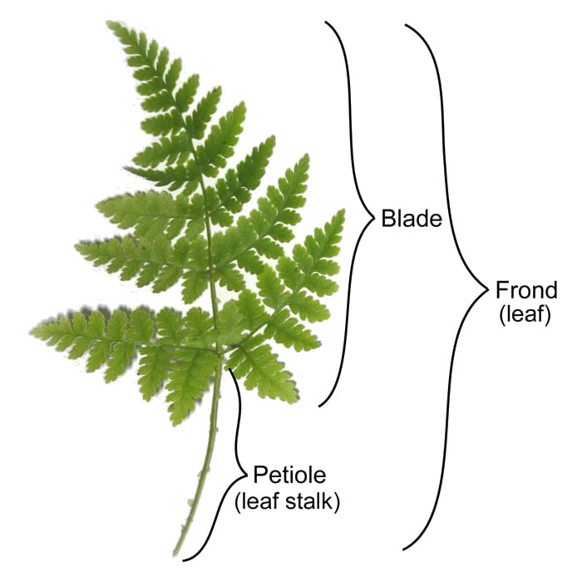
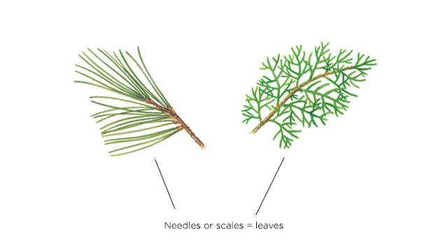
Types of Leaves Based on the Plants and Trees They are Found in
1) Fronds – Leaf of fern plants such as club-mosses and horsetails
2) Leaves of conifer – Found in plants such as fir and pine
3) Leaves of angiosperm – Leaves of common flowering plants such as rose, dahlia and, sunflower
4) Sheath leaves – Elongated and tubular leaves as found in variety of grasses
5) Specialized and unusual leaves – Leaves of insect-eating plants such as pitcher plant and venus flytrap.

Slide 41
The process by which one and the same organ appears in a variety of forms has been called the metamorphosis of plants.
Homologous organs are organs that have a similar structure but different functions. The homologous structures are similar anatomically because they were inherited from a common ancestor.
Analogous organs are the opposite of homologous organs, which are similar in function but possess different structural properties.

Slide 42
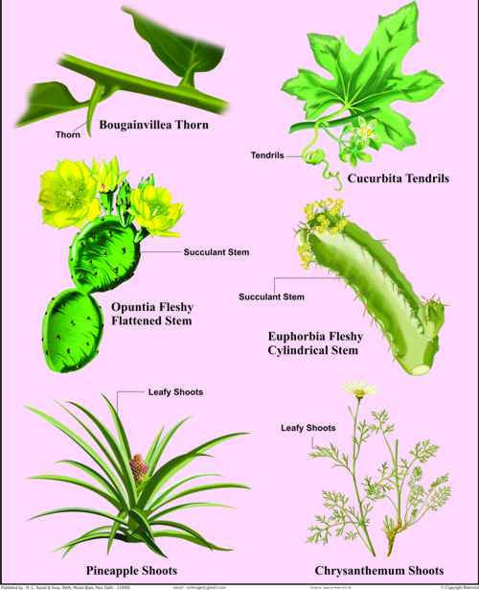
HOMOLOGOUS ORGANS OF PLANTS
Examples of homologous organs in plants:
Both Venus flytrap and Pitcher plants have modified their leaves to catch insects and digest them as food.
The plant poinsettia has modified its leaves which are bright red to look like the petals of a flower.
The thorns of a pomegranate and the tendrils of a passion fruit share common homology arising from an axillary bud but they are structurally and functionally different.
The cactus has modified its leaves into small spines to reduce water loss in arid climates with high temperatures and to protect itself from roving herbivores.

Slide 43
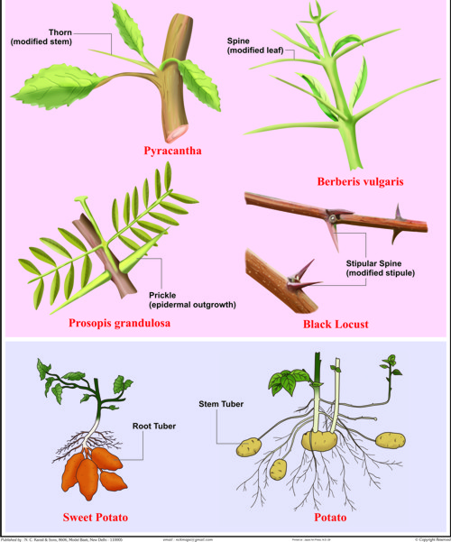
ANALOGOUS ORGANS OF PLANS
Examples of analogous organs in plants:
1. Potato is a stem while sweet potato is a root; both perform storage and vegetative propagation.
2. Cactus and Euphorbia belong to two different species but both have a photosynthetic stem and leaves reduced to spines.
3. Pyracantha (firethorn) and Berberis (barberry) both have thorns for protection but in firethorn plant, the thorns are modified stem while in barberry the thorns are modified leaves.

Slide 44
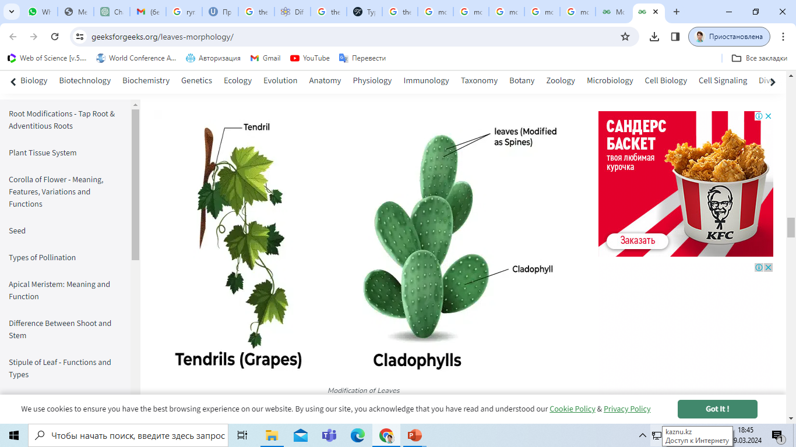
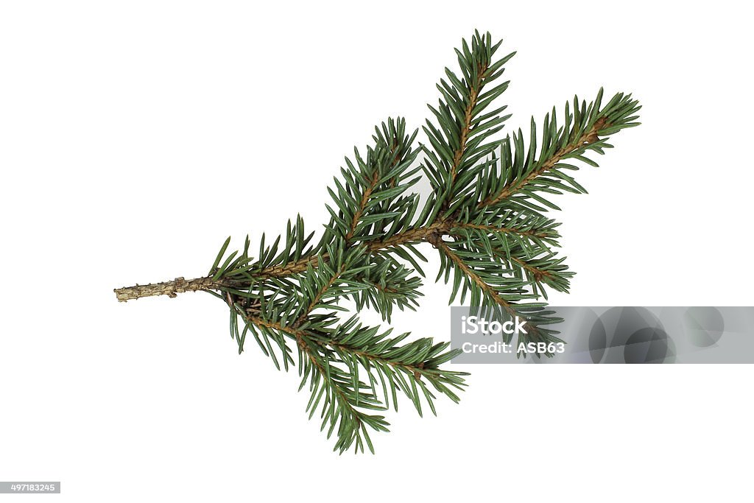
Modifications of Leaves
Mainly Leaves perform photosynthesis but these are also participate in different roles like storage of food, support, defence etc. To perform these functions Leaves are modified into different forms like:
Tendrils: When Leaves are modified into wiry and structures then these are called as tendrils, these are help the climbers to climb.
Spines : When Leaves are converted into pointed structure and these structures protect the plant from herbivores.

Slide 45
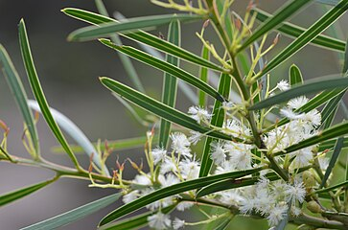
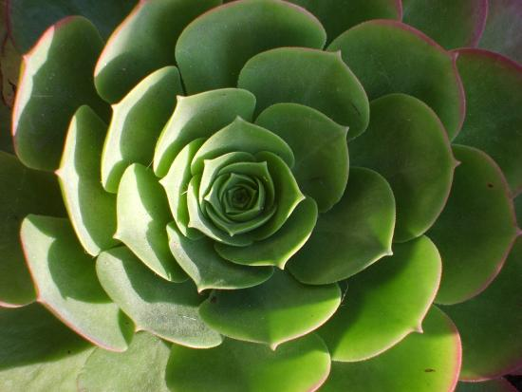
Phyllode: When petiole is modified into extended green structures which carries out photosynthesis (Acacia leaves).
Storage leaves: Due to storage of water and food these Leaves are become fleshy (Succulent plants: aloe)

Slide 46
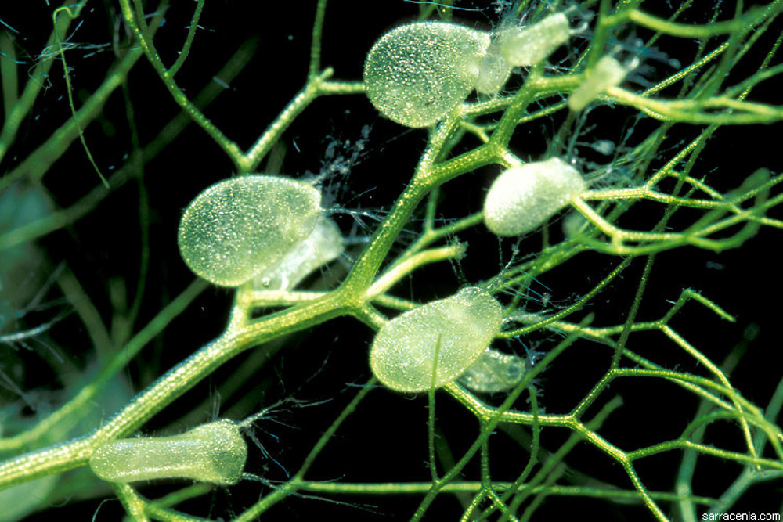
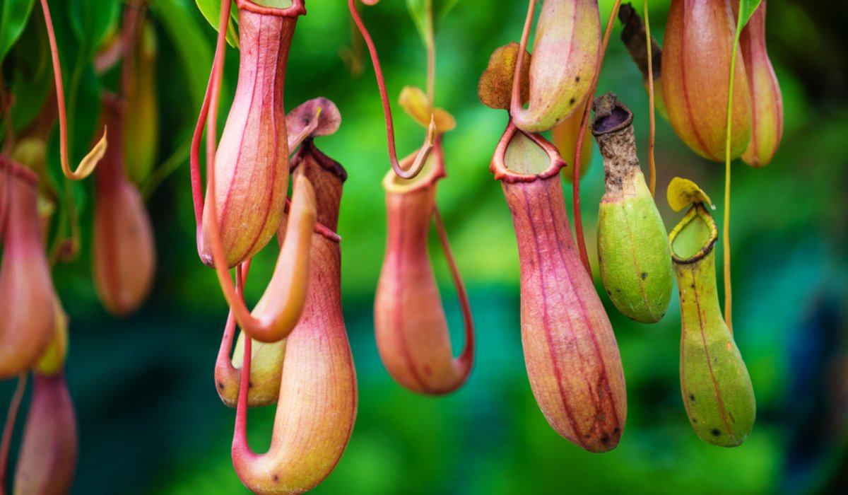
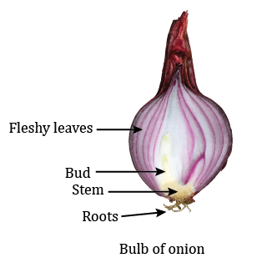
fleshy leaves
Leaf bladders: Leaves of the some aquatic plants are modified into leaf bladders which trap the small insects (Swollen bladderwort).
Leaf pitcher: Leaf lamina is modified into a lid which is called as pitcher and this trap the insects and fulfill nitrogen requirement. (Nepenthes)
Fleshy leaves of onion

Slide 47
Summary
Plants are composed of organs made up of tissues. Vegetative organs, including roots, stems, and leaves, facilitate growth, while reproductive organs are involved in sexual reproduction. Roots typically absorb water and nutrients from the soil, though some are aerial. The stem and leaves together form the shoot, with stems occurring both above and below ground, sometimes modified for storage or perennation. Leaves generally grow above ground, though some underground stems possess reduced leaves or swollen leaf bases.
Primary organs and tissues arise from the shoot and root apical meristems, with secondary tissues such as wood developing from lateral meristems. Adventitious roots form from differentiated cells that retain meristematic potential. During flowering, the shoot apical meristem transitions from a vegetative to a reproductive state, producing flowers on inflorescences, which may be solitary or grouped into a inflorescence.

